Slide 1

Modern Navigation Options in SharePoint Online
A Guided Tour Designed to Help You Select an Effective Navigation Strategy

Slide 2
Team Sites
Modern Navigation in Team Sites

Slide 3
Team Site Navigation Options
Top link bar customizable via ~sitecollection/layouts/15/topnav.aspx
Hidden from the UI in a team site connected to an Office 365 Group
Left navigation supports up to 2 levels
Header can be standard or compact

Slide 4
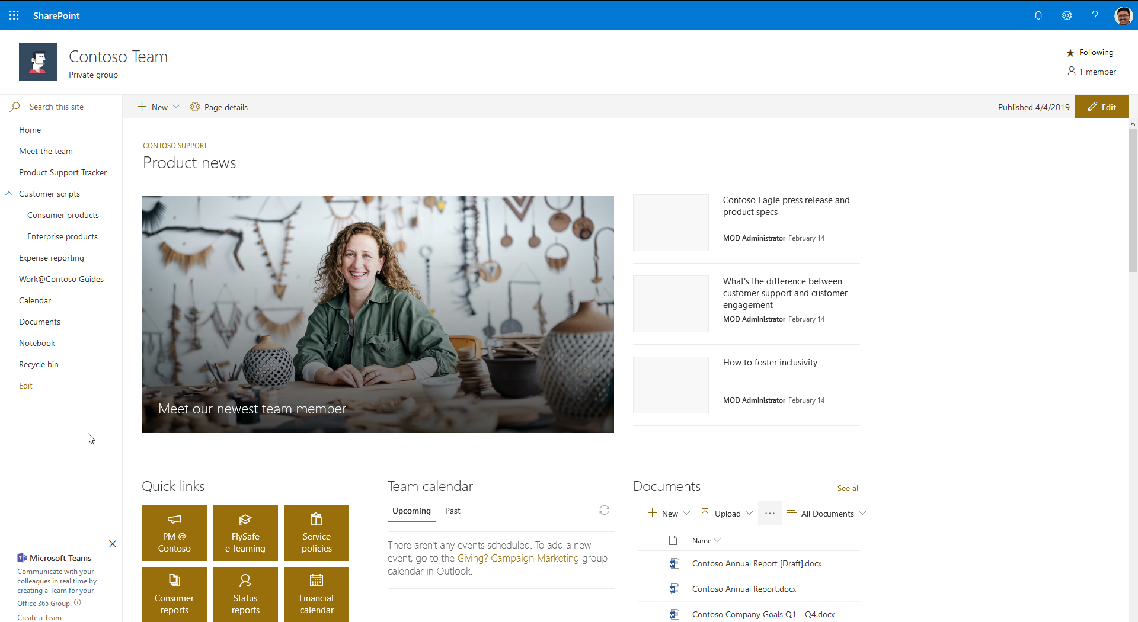
Team Site – Standard Header

Slide 5

Team Site – Standard Header with Top Nav Links

Slide 6
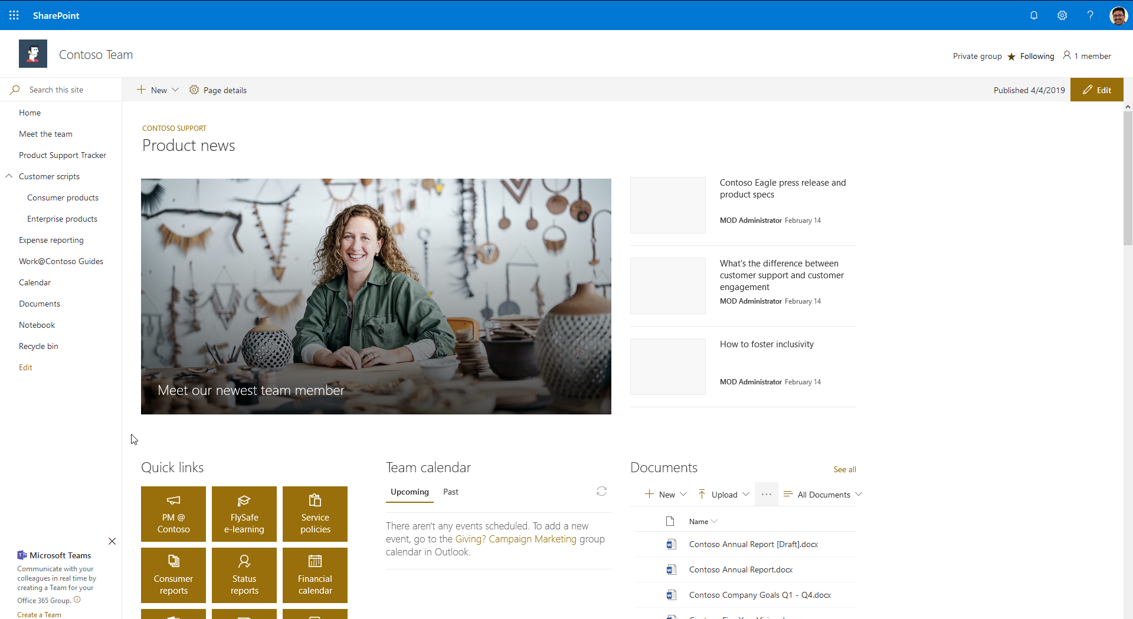
Team Site – Compact Header

Slide 7

Team Site – Compact Header with Top Nav Links

Slide 8
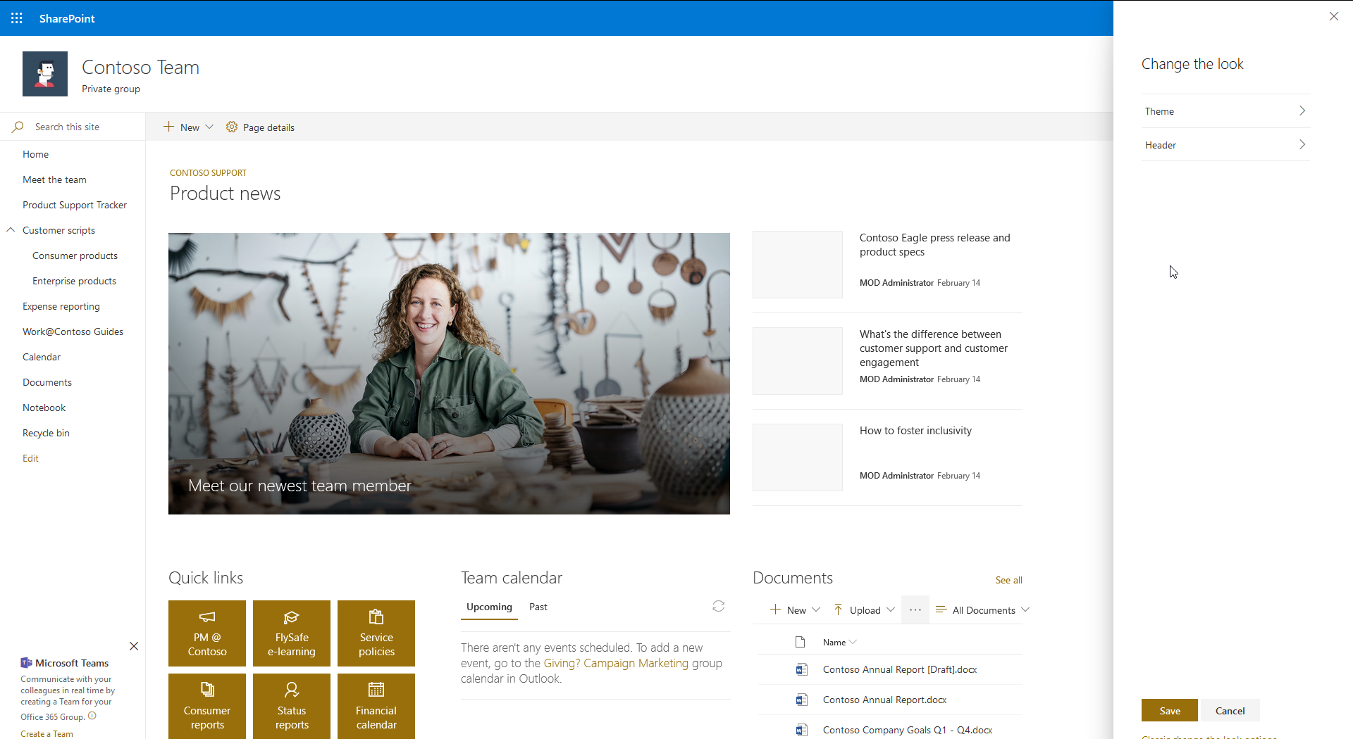
Team Site – “Change the look” Options

Slide 9
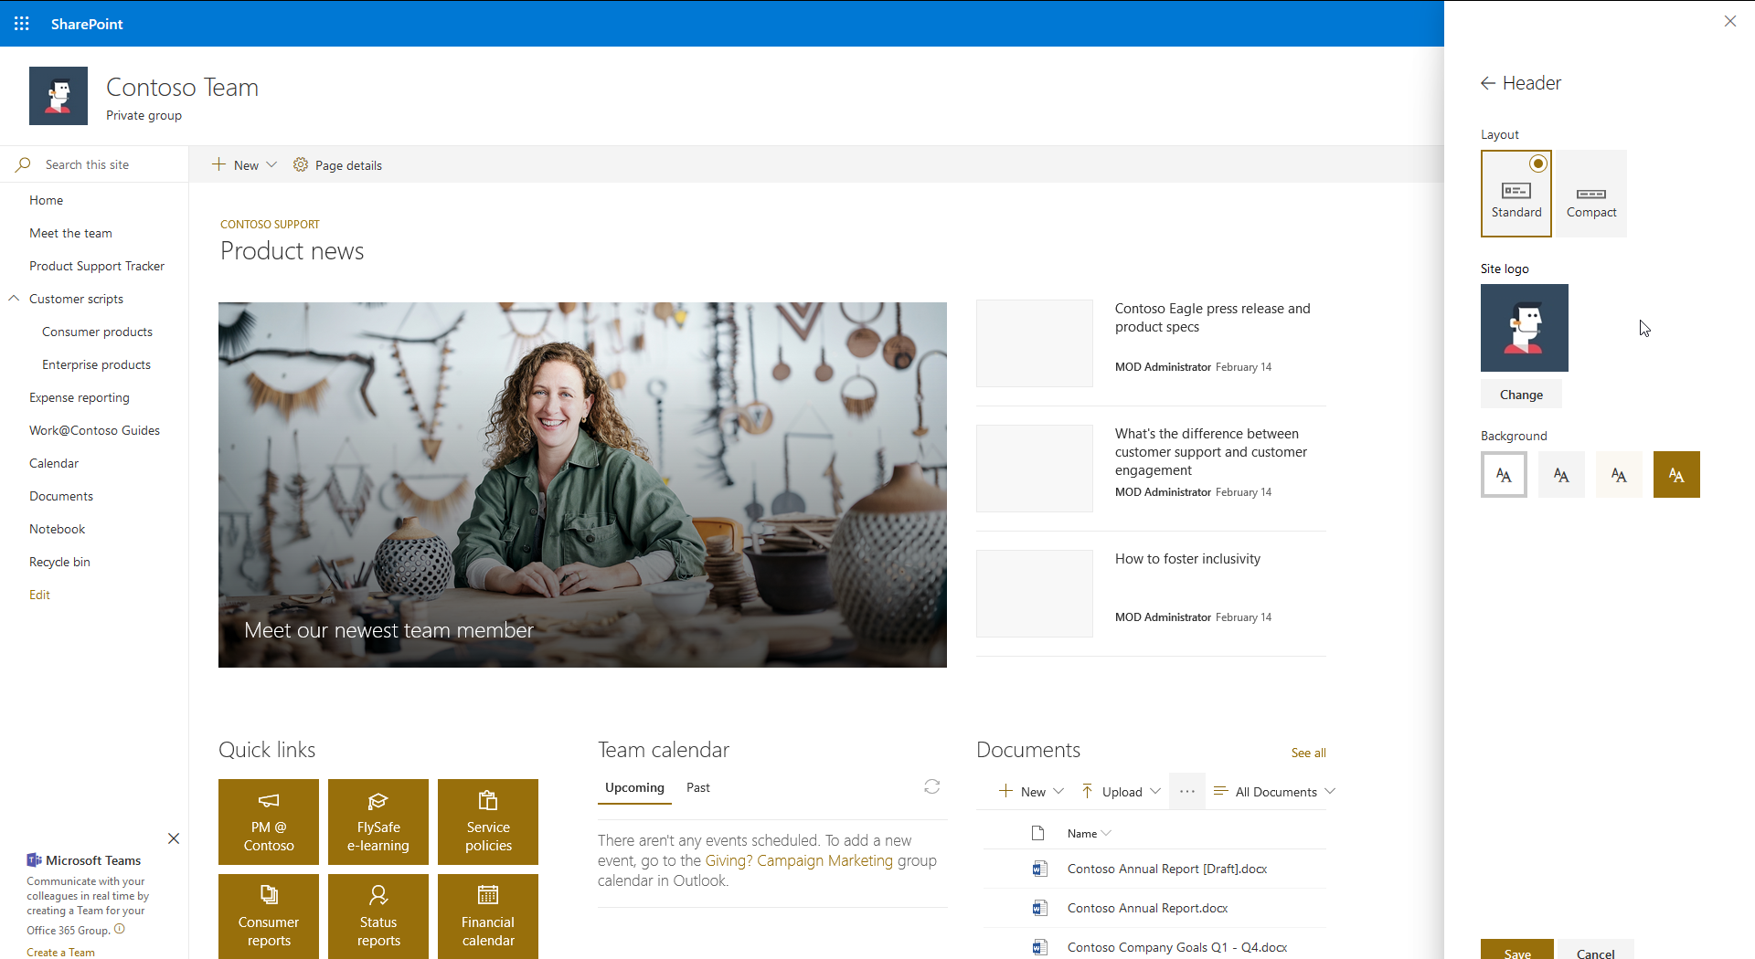
Team Site – Header Options

Slide 10
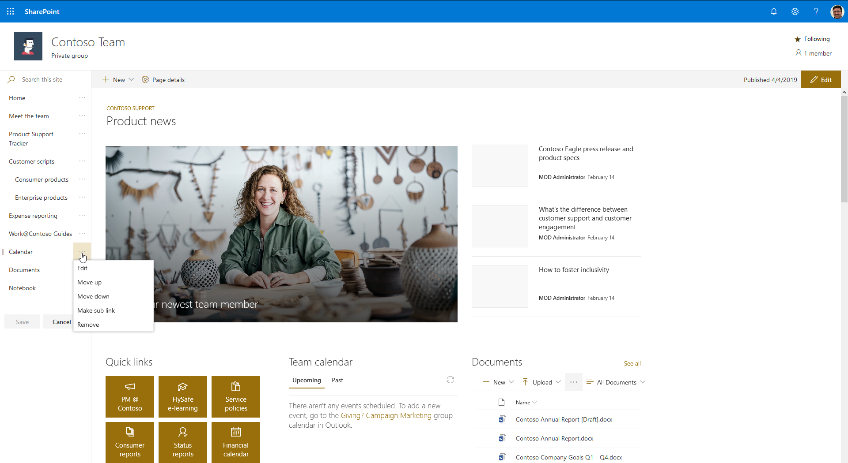
Team Site – Editing Navigation Links

Slide 11
Communication Sites
Modern Navigation in Communication Sites

Slide 12
Communication Site Navigation Options
Page at ~sitecollection/layouts/15/topnav.aspx has no effect
Top navigation supports up to 3 levels
Top navigation can be configured as cascading drop-downs or as a mega menu
No left navigation
Header can be standard or compact

Slide 13
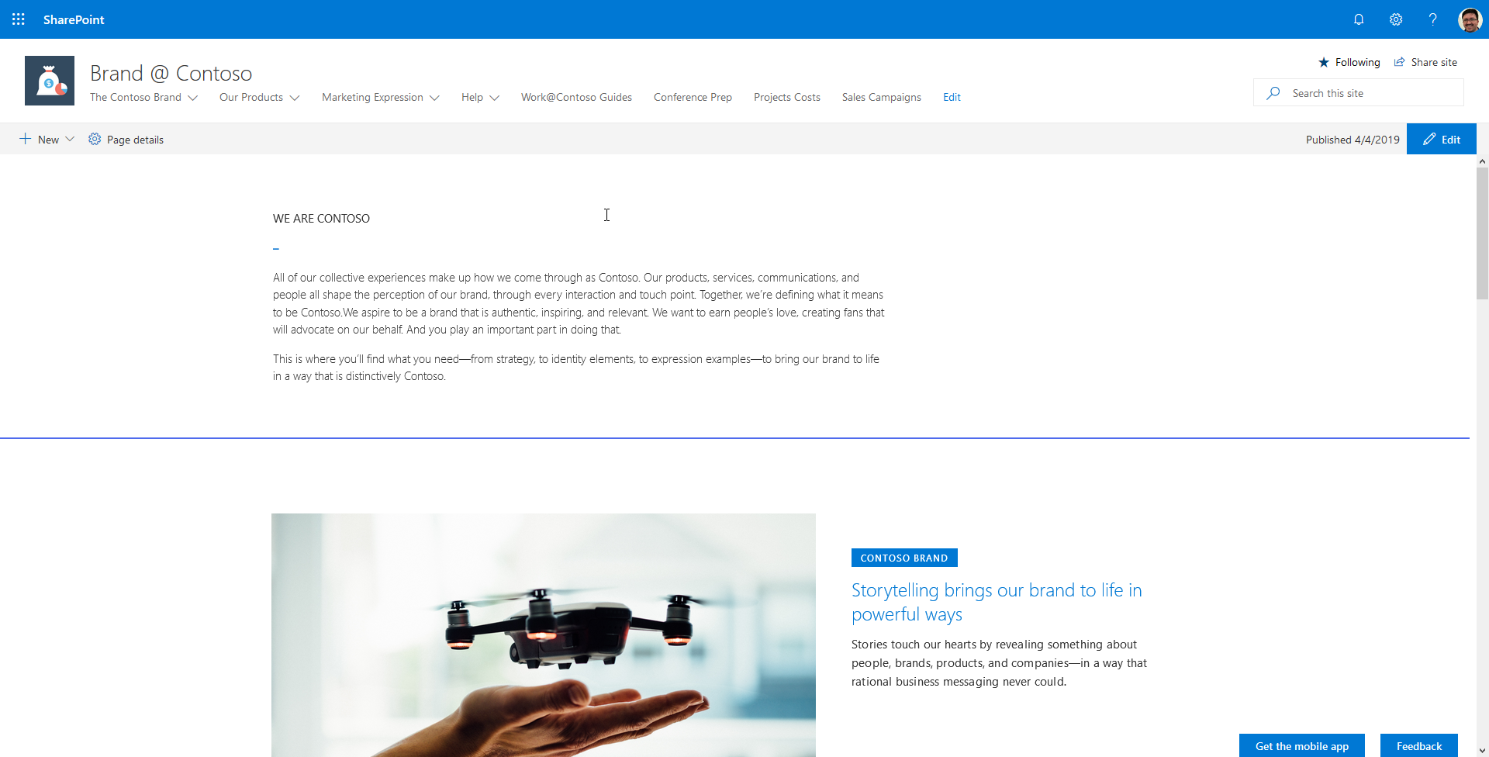
Communication Site – Standard Header

Slide 14
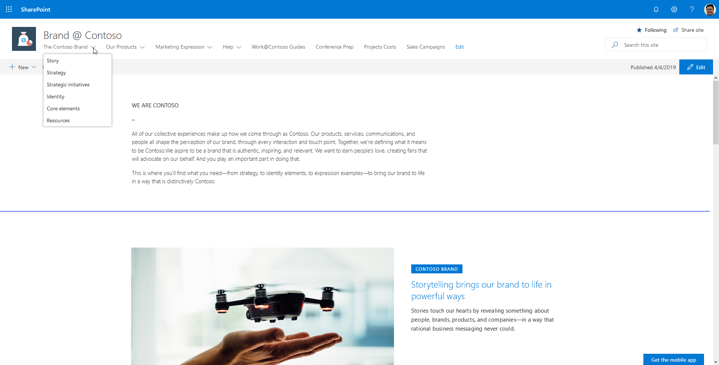
Communication Site – Standard Header, Cascading Navigation

Slide 15
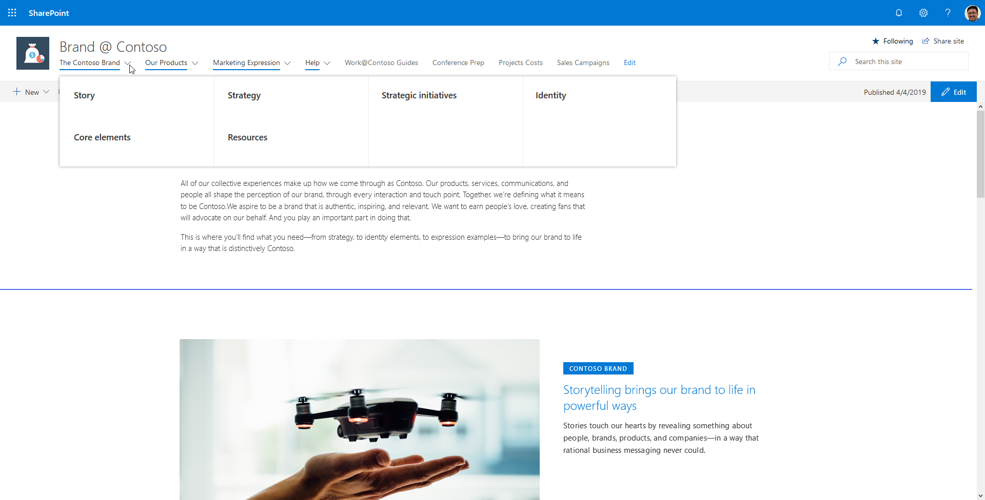
Communication Site – Standard Header, Mega Menu Navigation

Slide 16
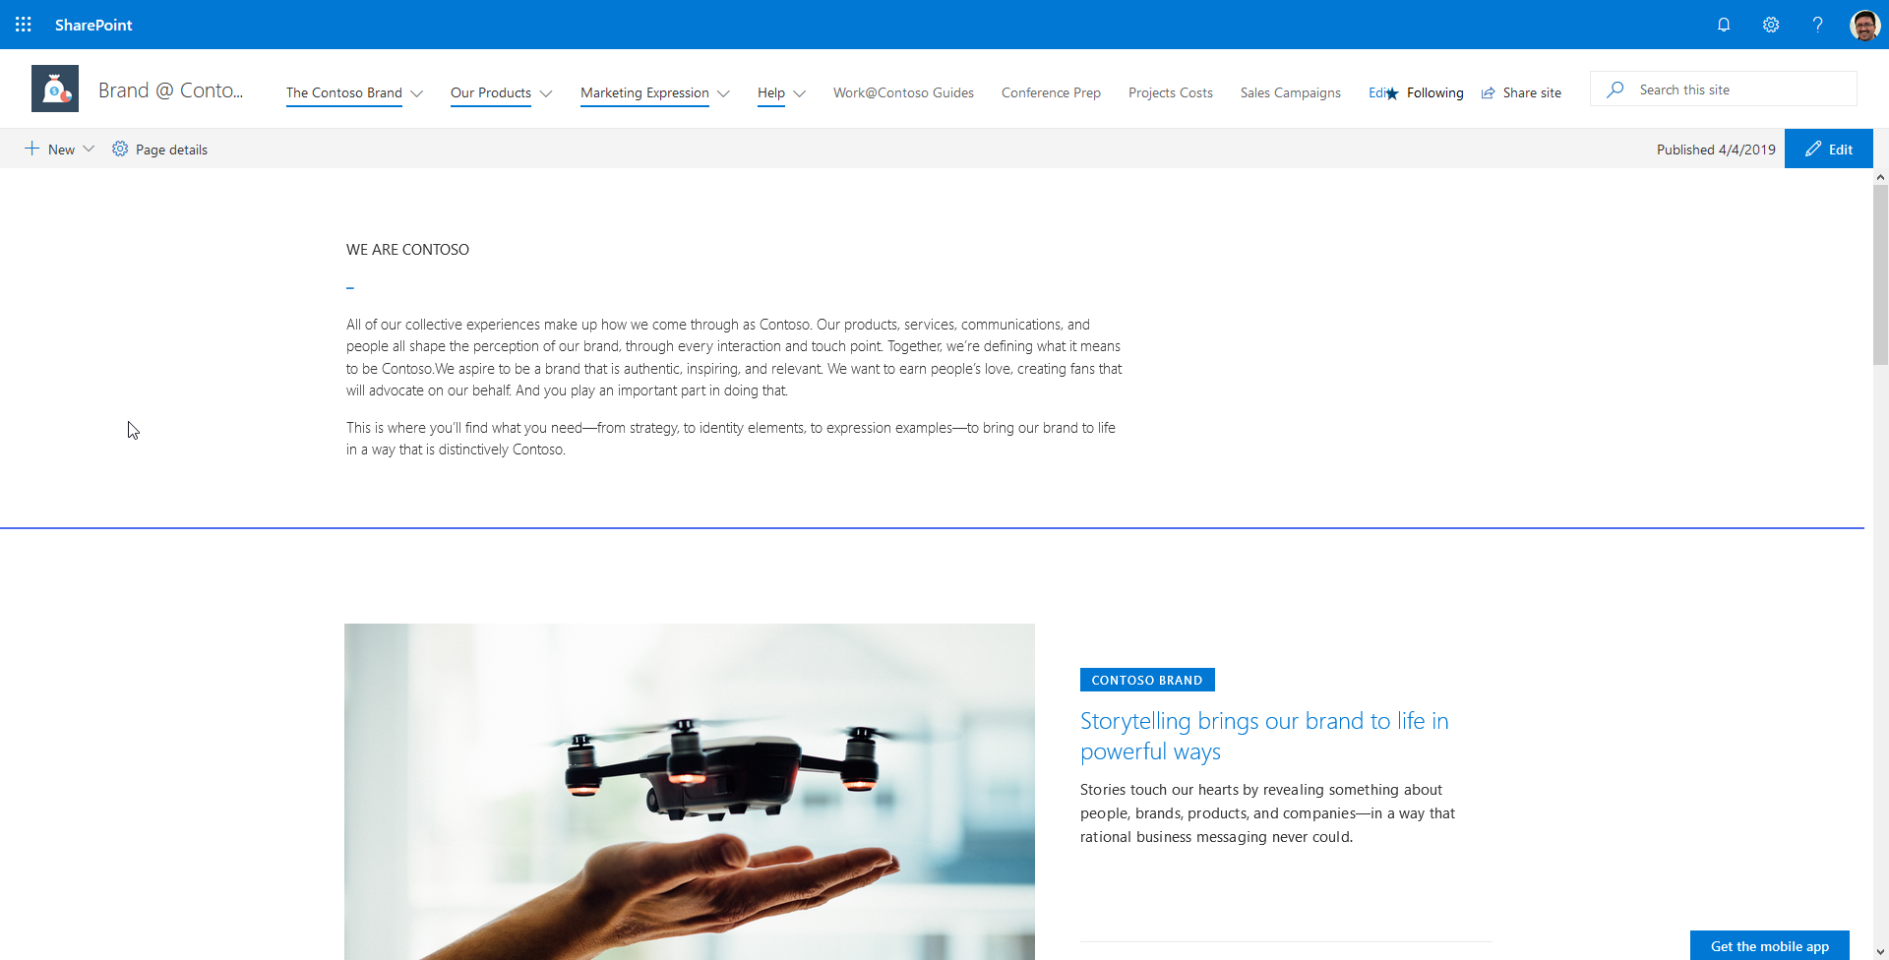
Communication Site – Compact Header

Slide 17
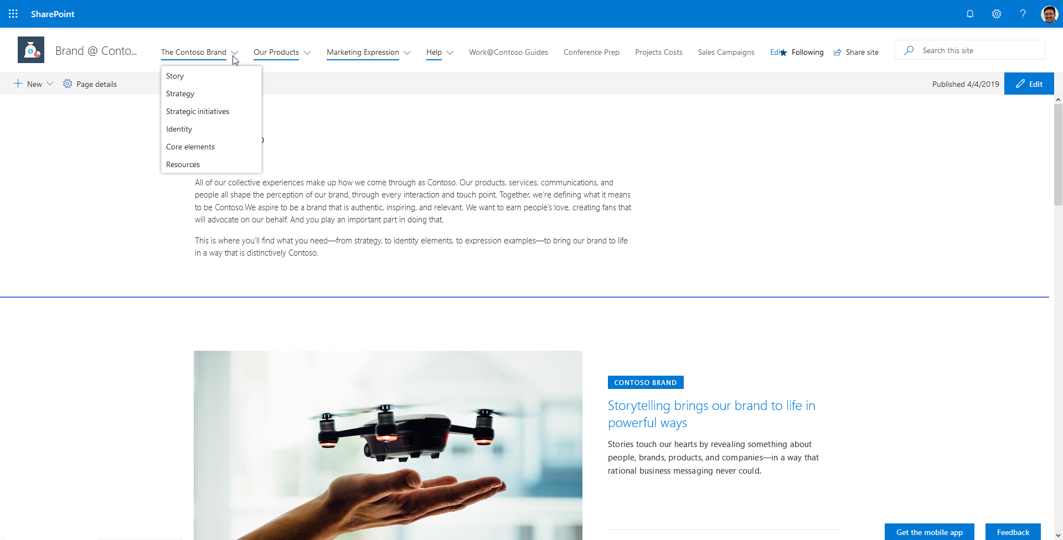
Communication Site – Compact Header, Cascading Navigation

Slide 18
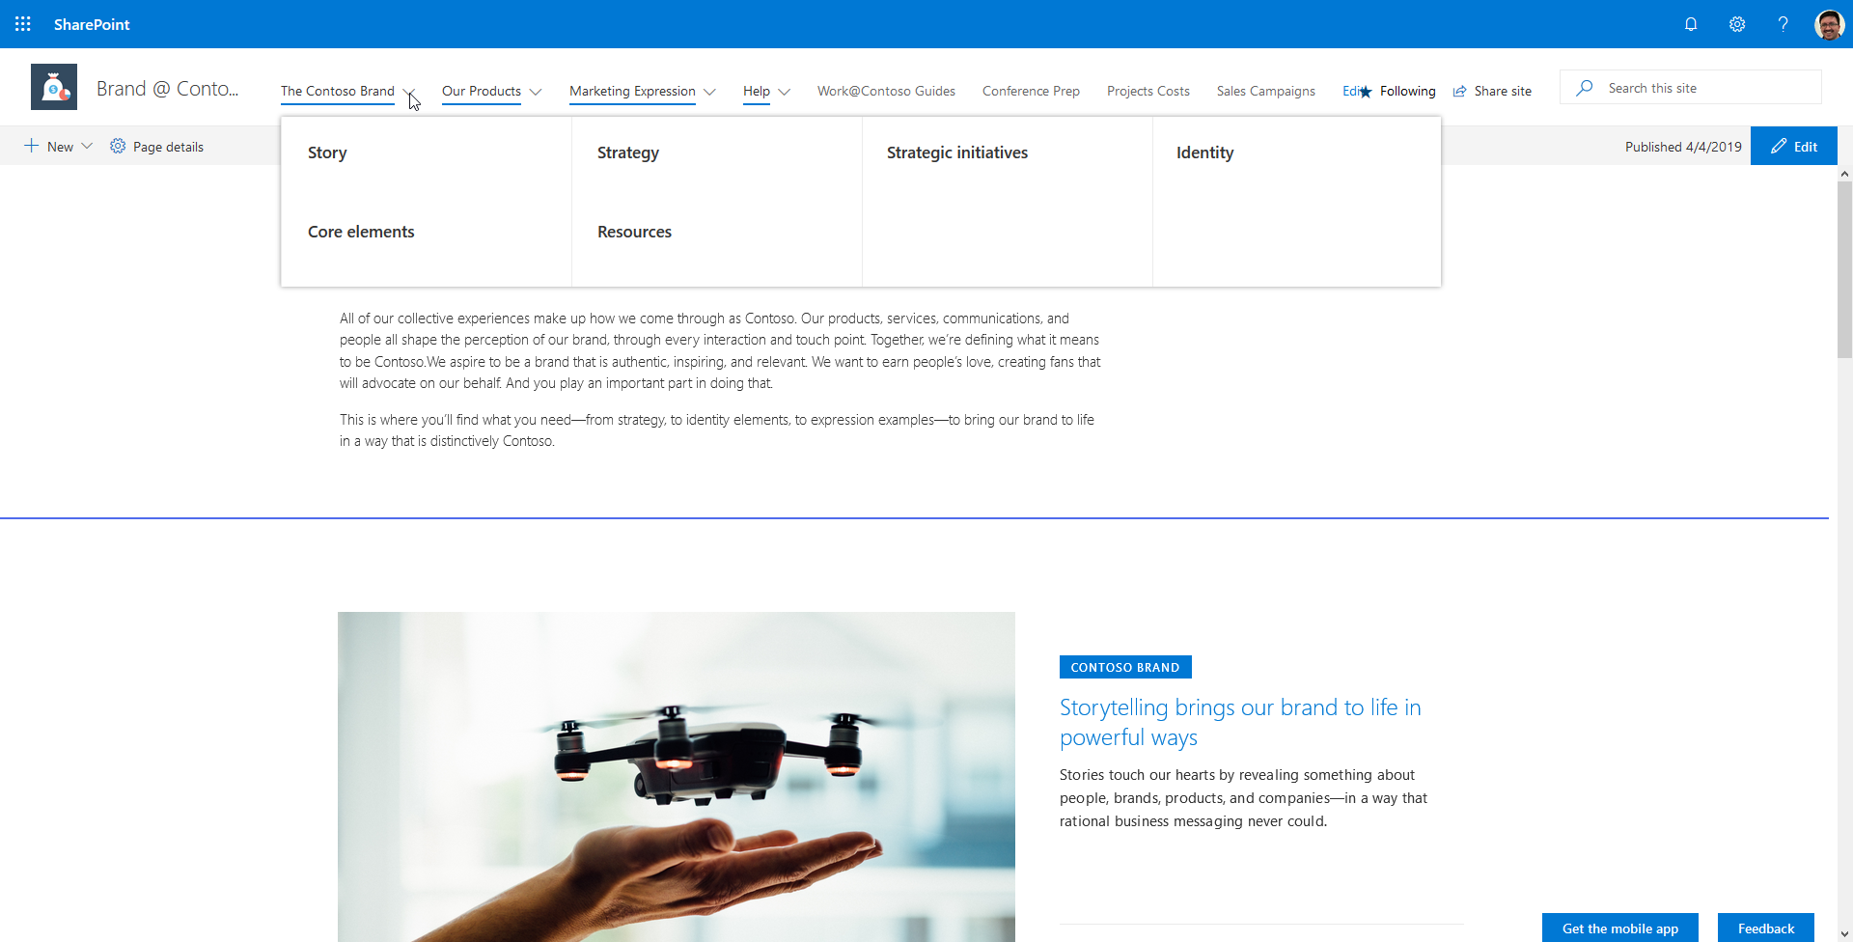
Communication Site – Compact Header, Mega Menu Navigation

Slide 19
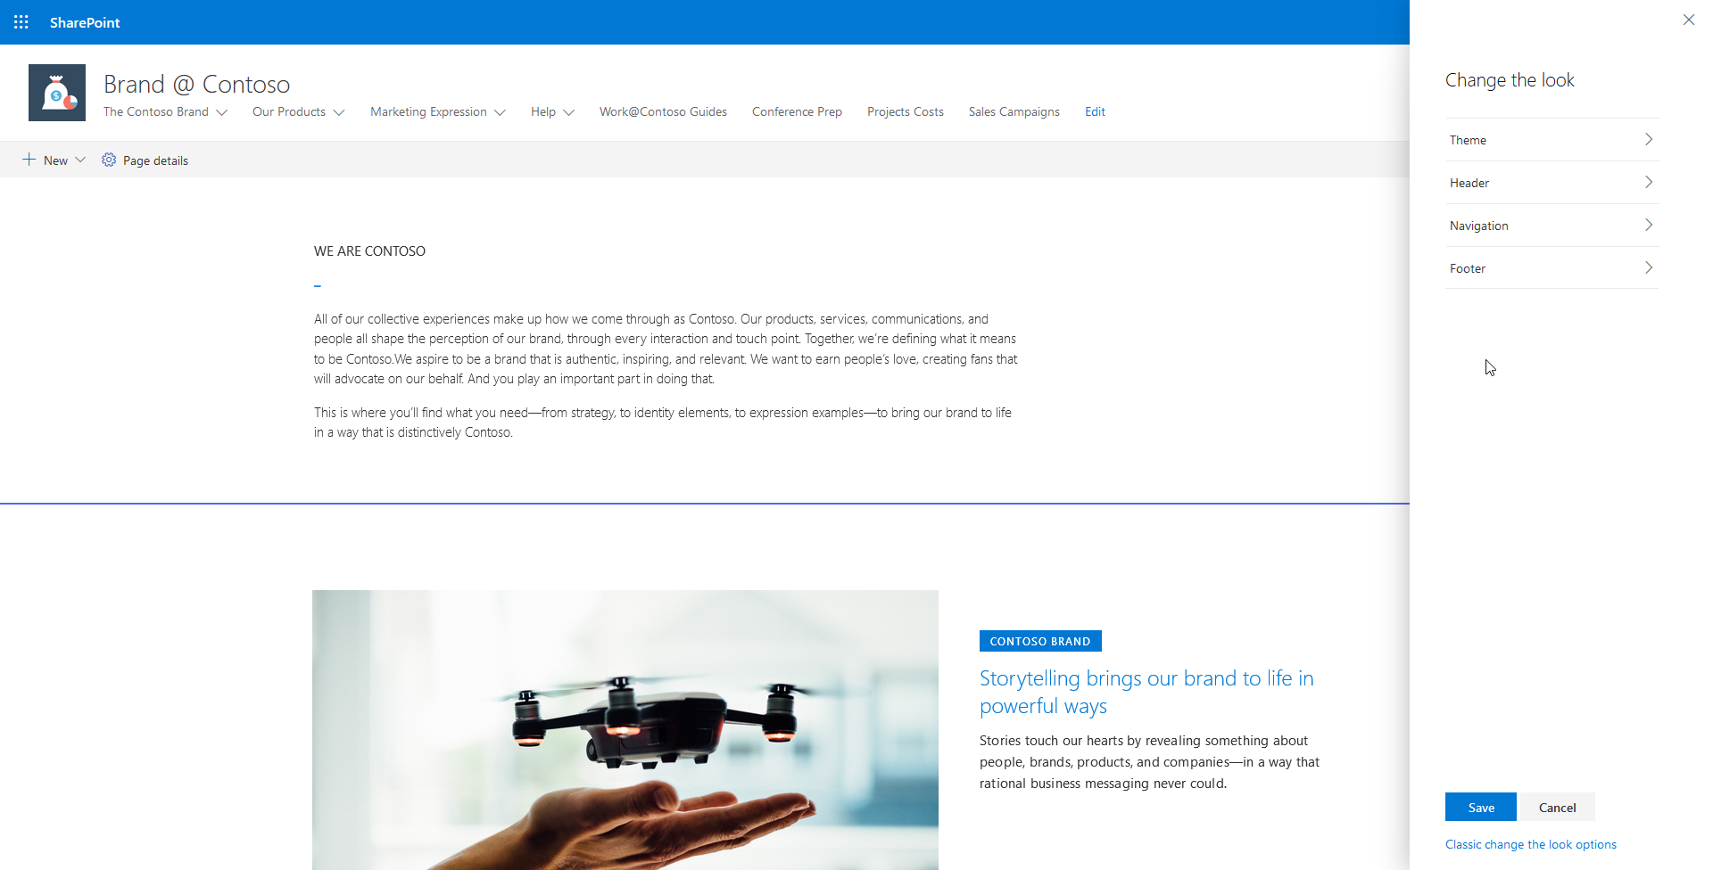
Communication Site – “Change the look” Options

Slide 20
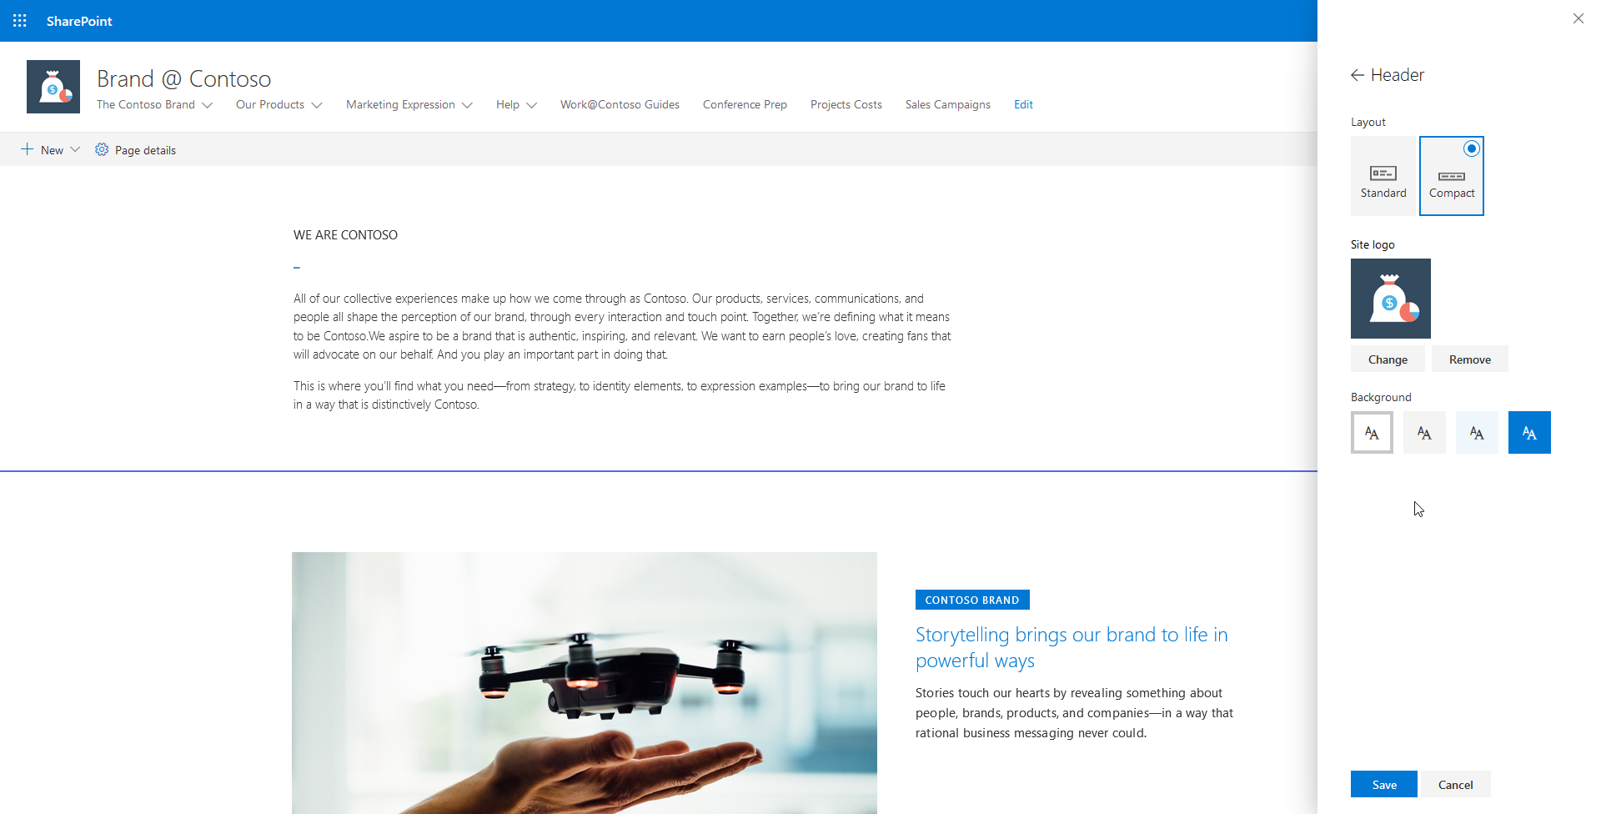
Communication Site – Header Options

Slide 21
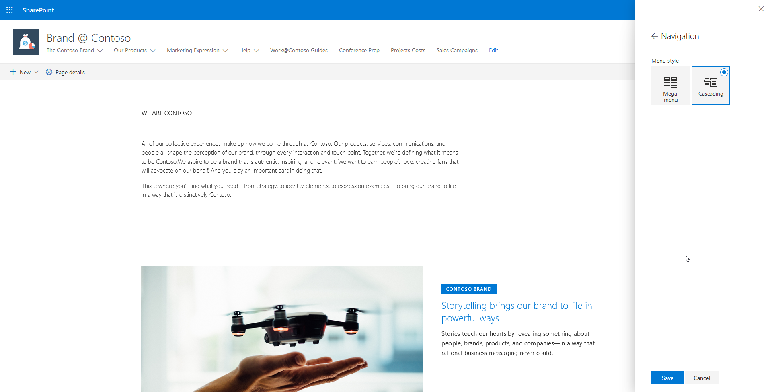
Communication Site – Navigation Options

Slide 22
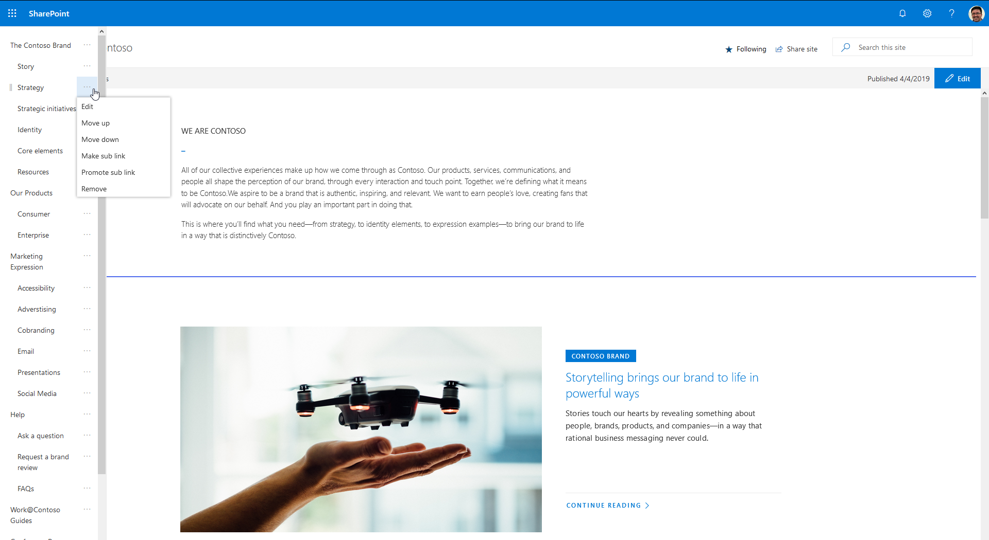
Communication Site – Editing Navigation Links

Slide 23
Hub Sites
Modern Navigation with Hub Sites

Slide 24
Hub Site Navigation Options
Select a site collection to be the “hub”
You can use multiple site collections to create multiple “hubs”
Customize the navigation in the hub
Associate other site collections to the hub
Can associate both team and communication sites
Associated sites inherit the hub navigation and have their own
Hub site navigation is not truly a global navigation solution
Only applies to the sites that are associated with the hub

Slide 25
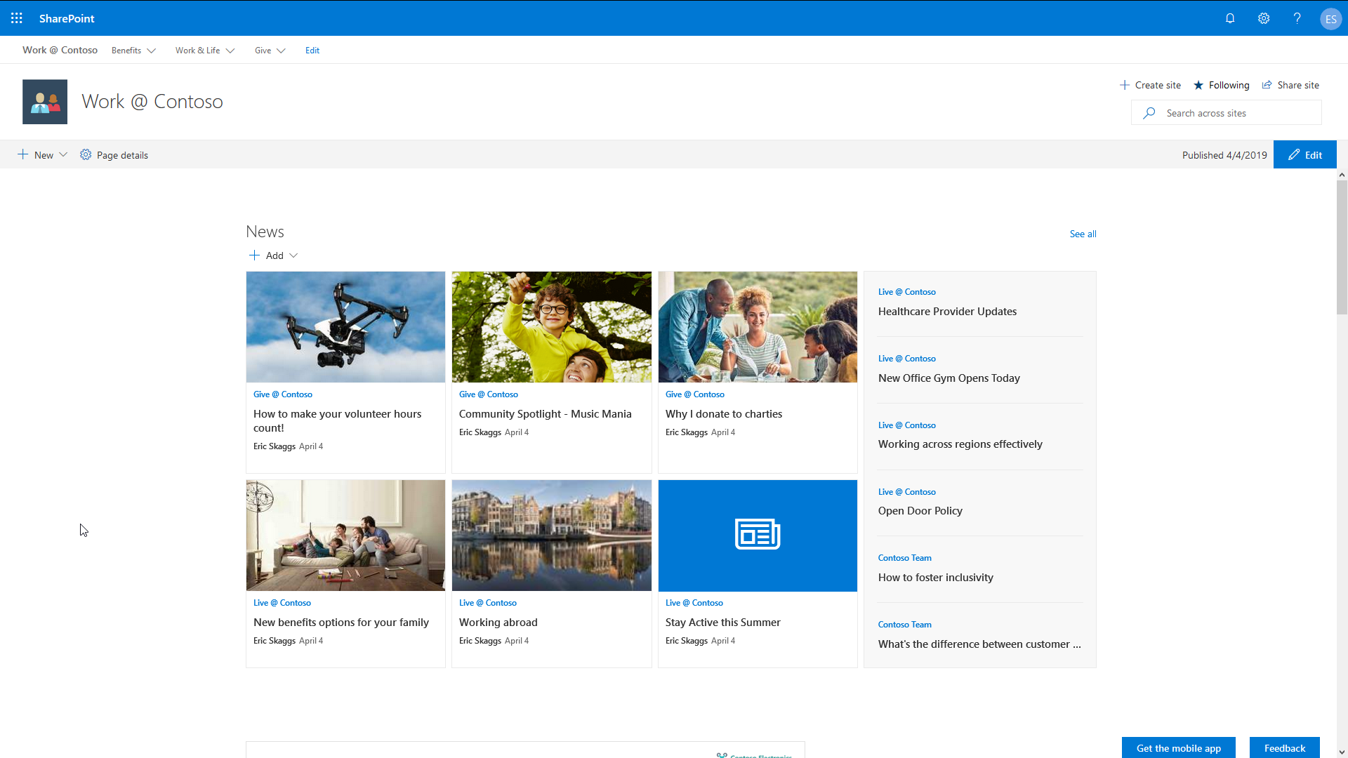
Hub Site

Slide 26
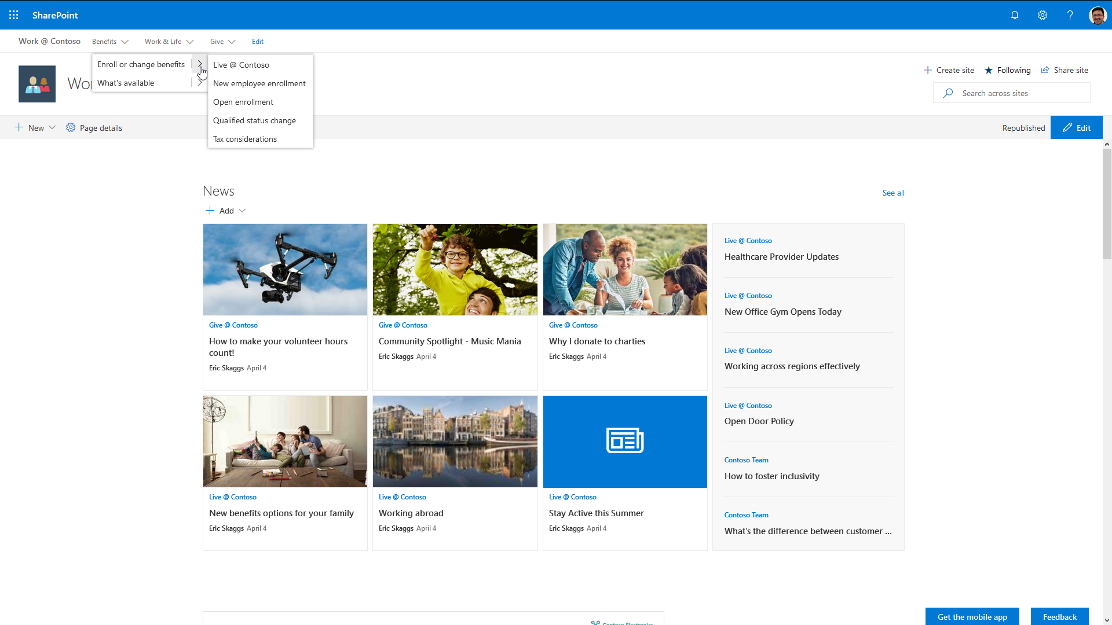
Hub Site – Standard Header, Cascading Navigation

Slide 27
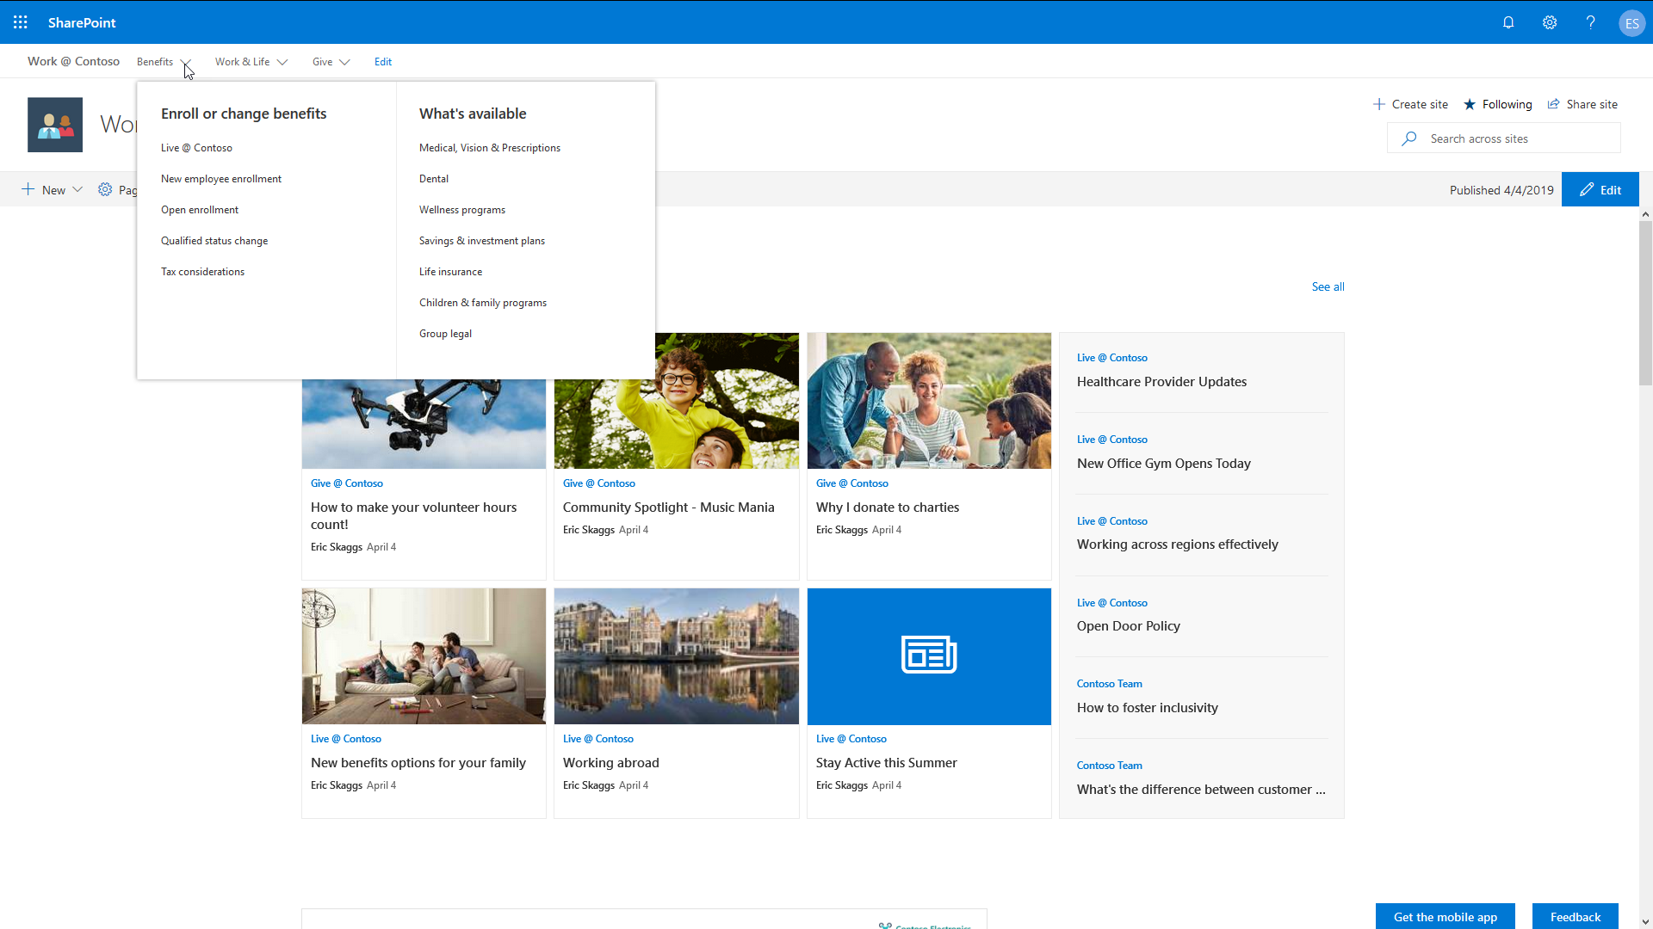
Hub Site – Standard Header, Mega Menu Navigation

Slide 28
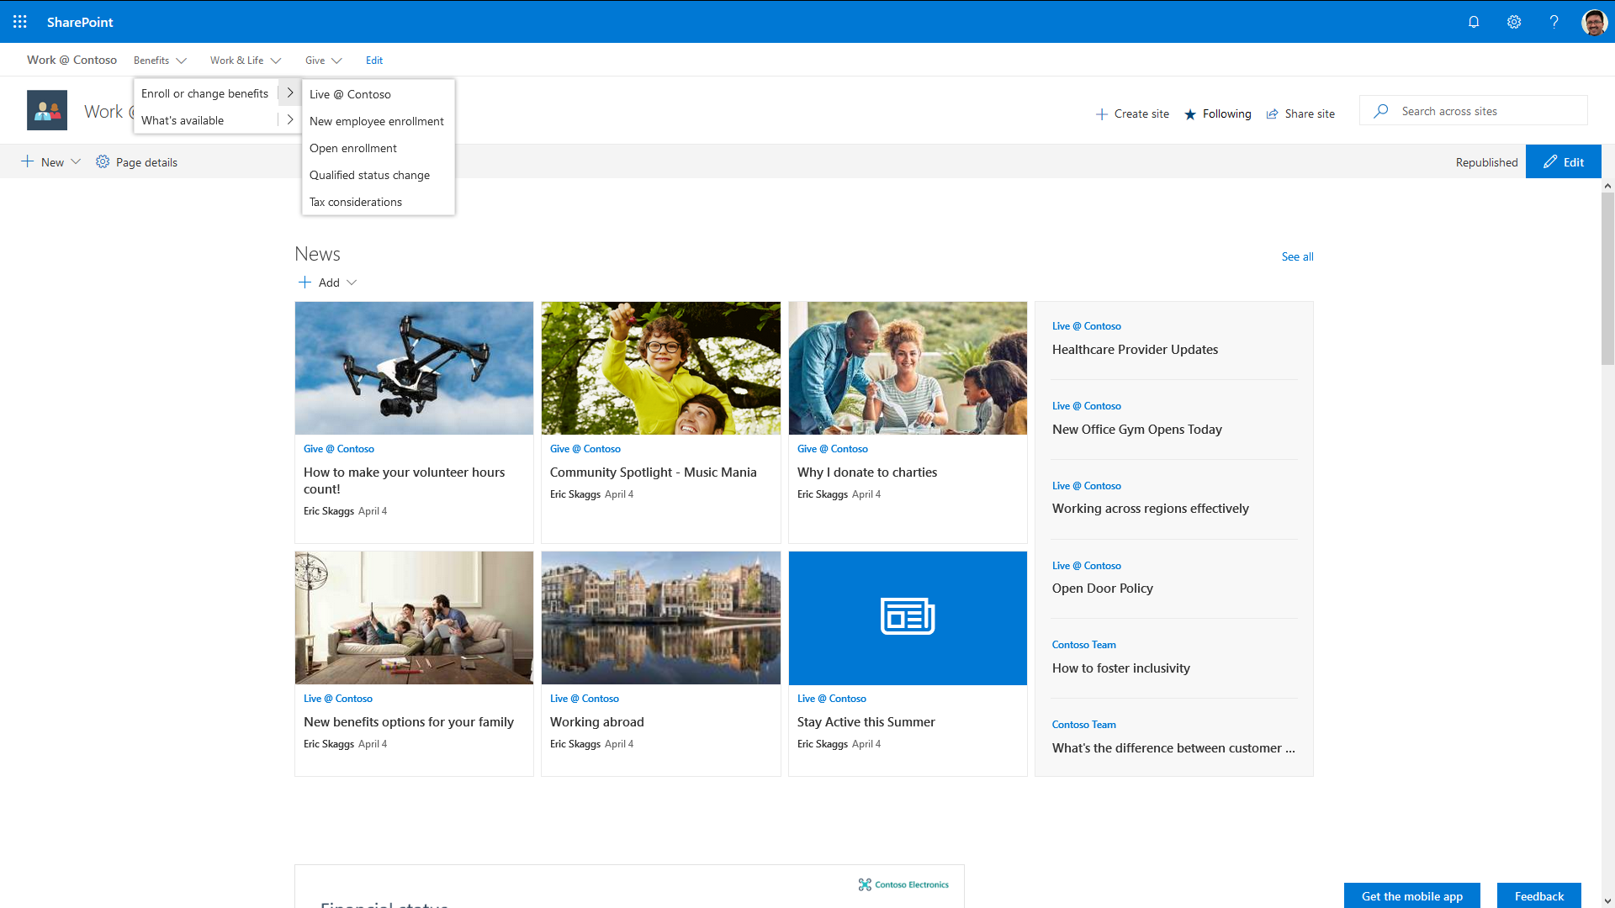
Hub Site – Compact Header, Cascading Navigation

Slide 29
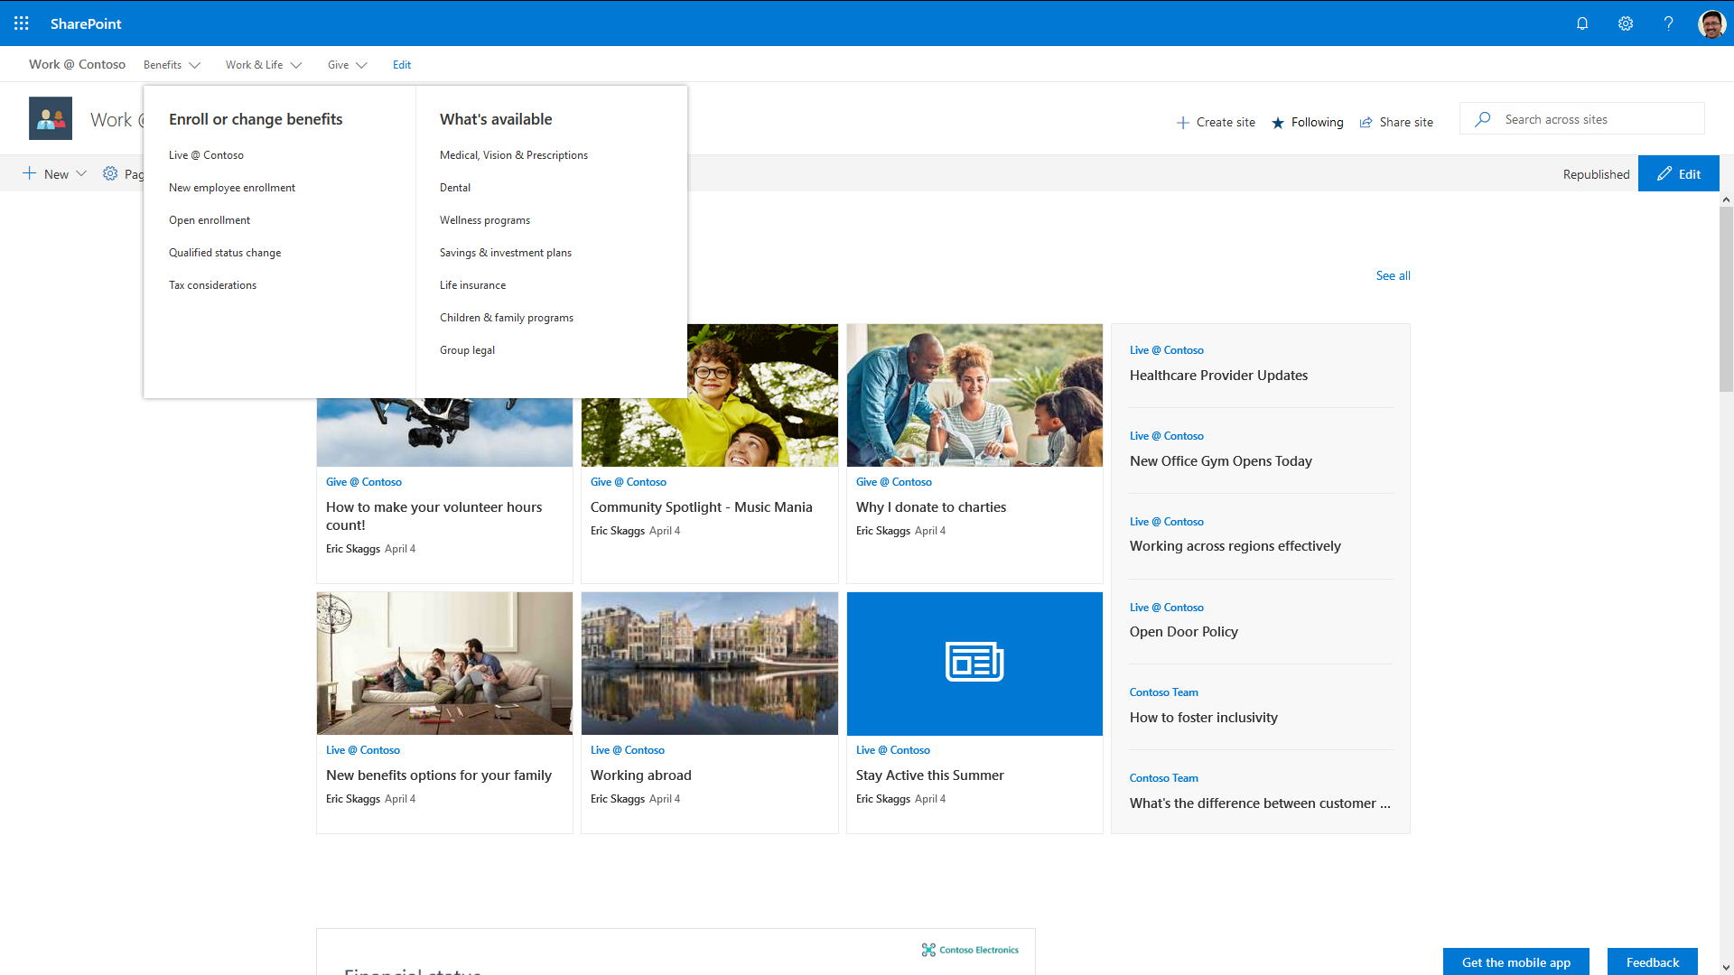
Hub Site – Compact Header, Mega Menu Navigation

Slide 30
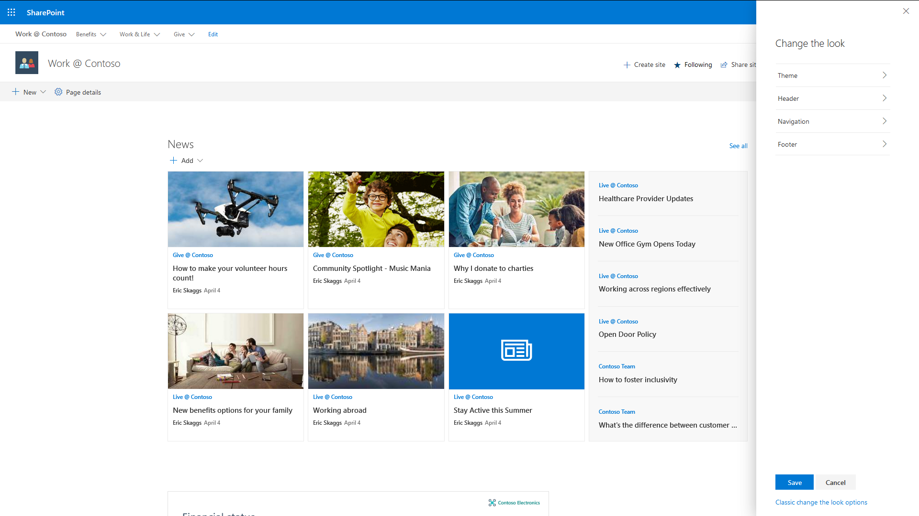
Hub Site – “Change the look” Options

Slide 31
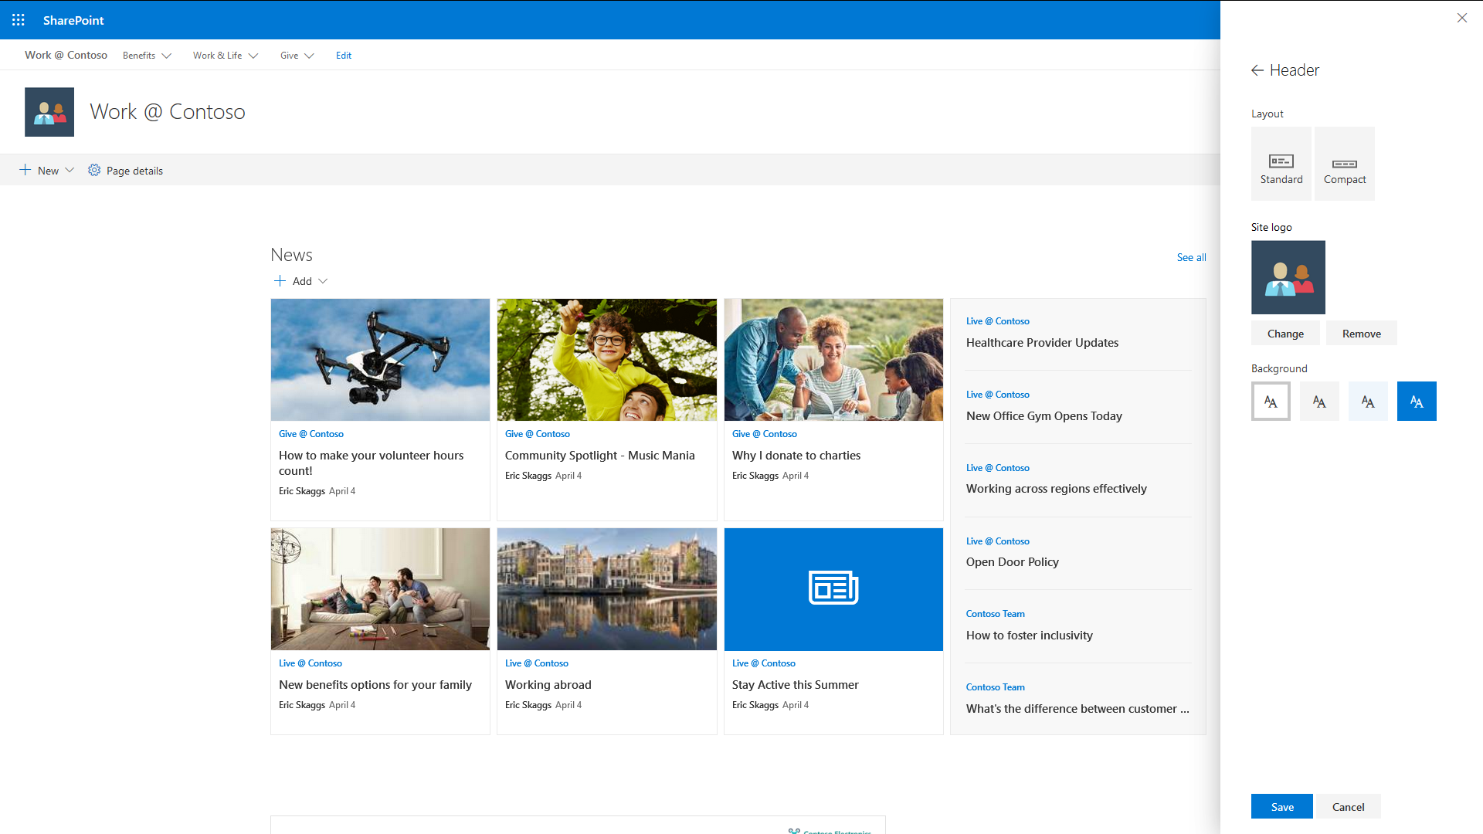
Hub Site – Header Options

Slide 32
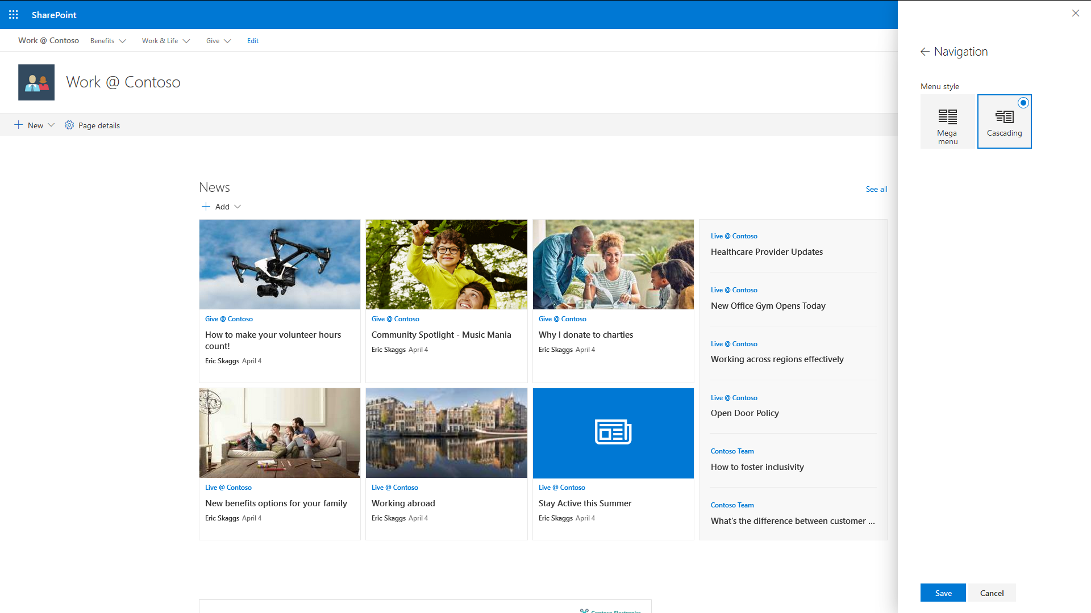
Hub Site – Navigation Options

Slide 33
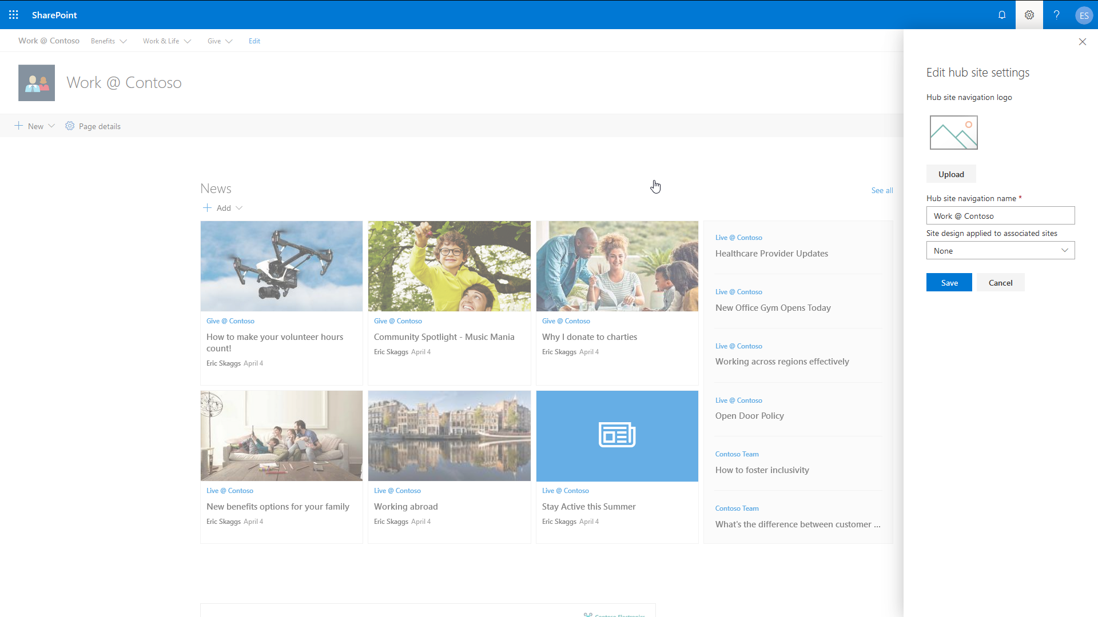
Hub Site Settings

Slide 34
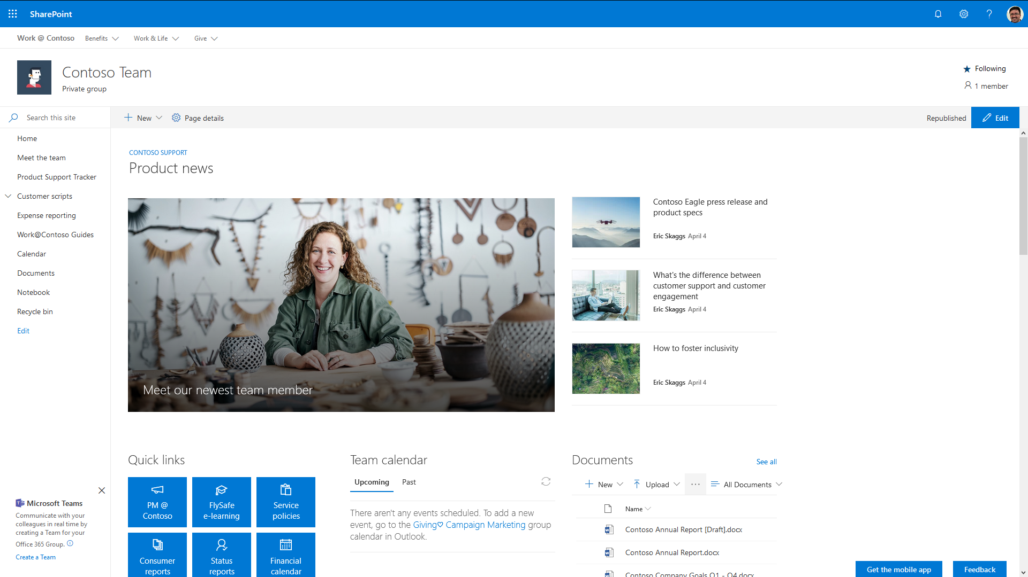
Hub Site – Team Site Associated with Hub

Slide 35
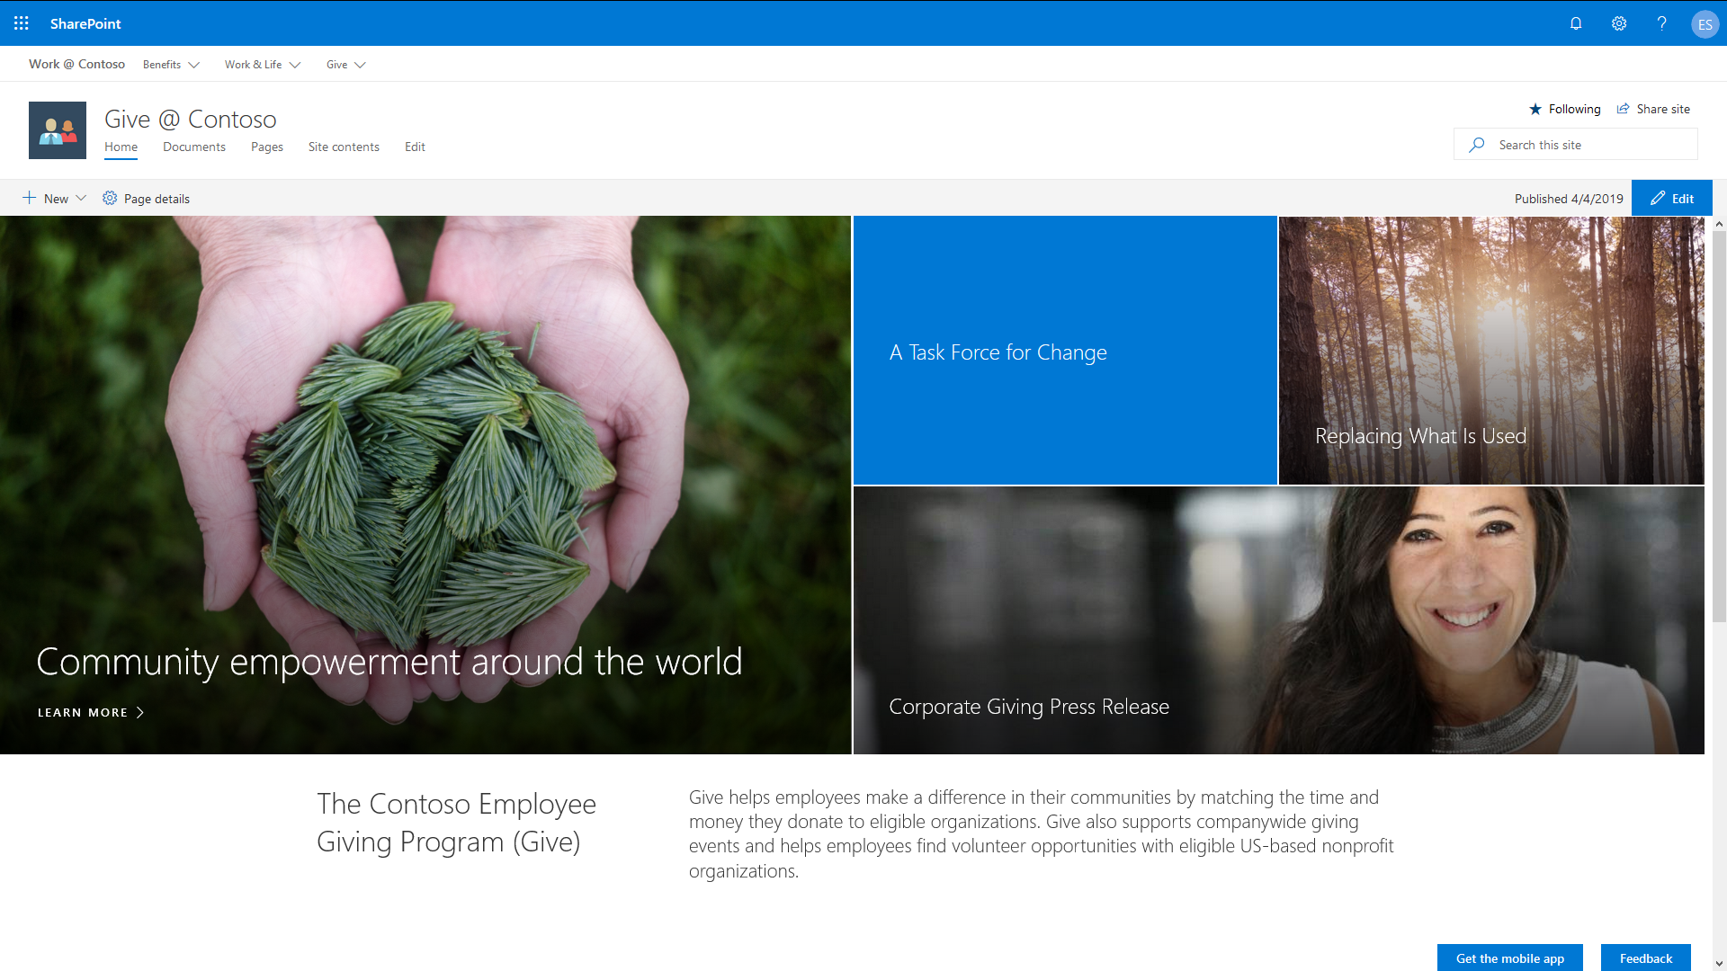
Hub Site – Communication Site (Showcase) Associated with Hub

Slide 36
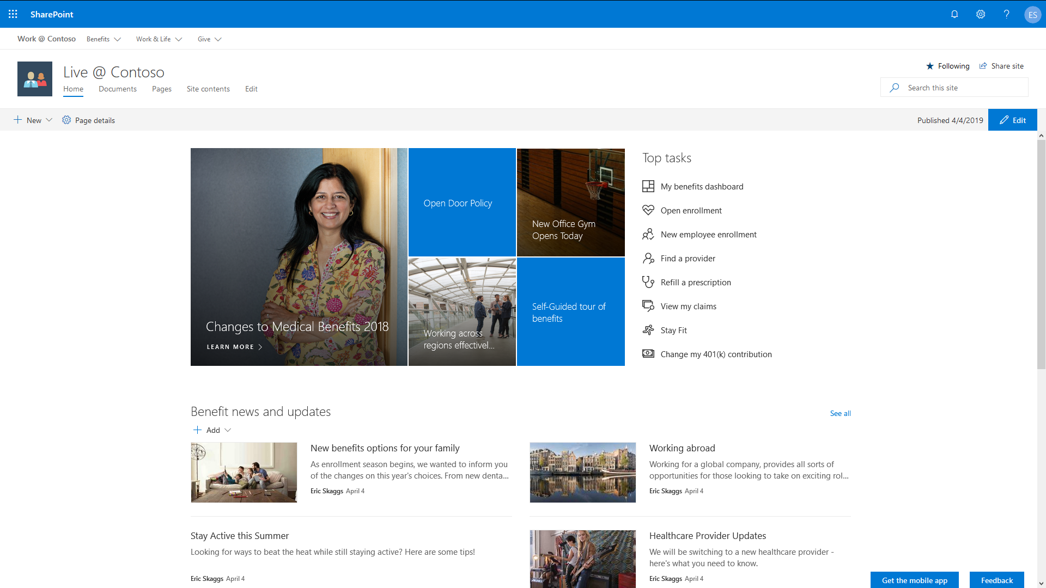
Hub Site – Communication Site (Topic) Associated with Hub

Slide 37
Thank you.

